Slide 1



Slide 2
Student Name: adi dereviani id: 305674731 Department: Computer Science
Programming for Everyone: An Introduction to Visual Languages
With Dr. Michal Gordon

Slide 3
Personal Assistant Robot

Slide 4



introduction
Robotic personal assistant is a robot that helps you with day-to-day household tasks, making your life easier.
Although many of such tasks can also be done by humans, there are potential qualitative benefits in using robots.

Slide 5
Inputs & Outputs
internal:
// Voice Sensors
event SayAwake
event SayAsleep
event SaySit
event SayInAction
event SayClean
event SayCook
event SayDoLaundry
event SayPlaylist
event SayQuiet
//triggered events
event TaskCompleted
event Preparation
Input:
The user says ”awake”
The user says ”asleep”
The user says ”sit”
The user says “in action”
The user says “clean”
The user says “cook”
The user says ”do laundry”
The user says “playlist”
The user says “quiet”
Output:
The Robot wakes up.
The Robot goes to sleep.
The Robot sits down.
The Robot is preparing to execute some action.
The Robot cleans what the user requests.
The Robot make a meal.
The Robot do laundry.
The Robot plays music.
The Robot silences the music.

Slide 6
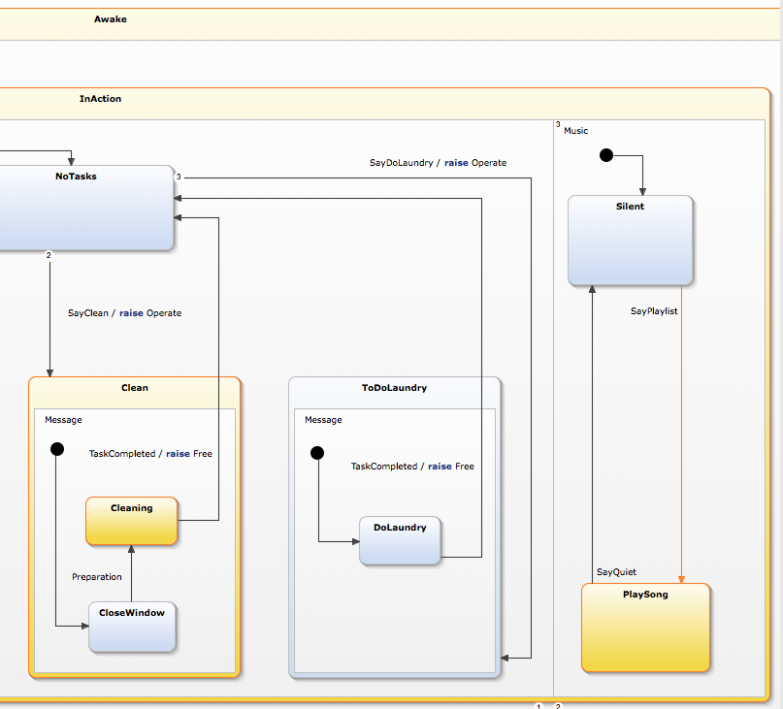
Example of Reactivity
Personal assistant Robot is a reactive system which can understand user’s voice, interpret user’s commands to actions and
execute a few commands in parallel.
He has sensors that help him understand the environment as if he were a real person.
For example, you could tell the robot to clean up and at the same time play music for you.
Here are a few examples of some states and transitions in the statecharts:
States:
The robot has two states: Awake / Asleep, within the ‘Awake’ state there are two states: In action / Sit.
In the ’in action’ state, the robot can be in 2 orthogonal states: ‘music’ and ‘operations’.
Transitions:
Switching from ‘sit’ state to ‘in action’ state.
Switching from ‘No tasks’ state to a state of doing ‘home tasks’ such as: cleaning, cooking or do laundry.
Switching from ‘Silent’ state to ‘Play a song’ state.

Slide 7
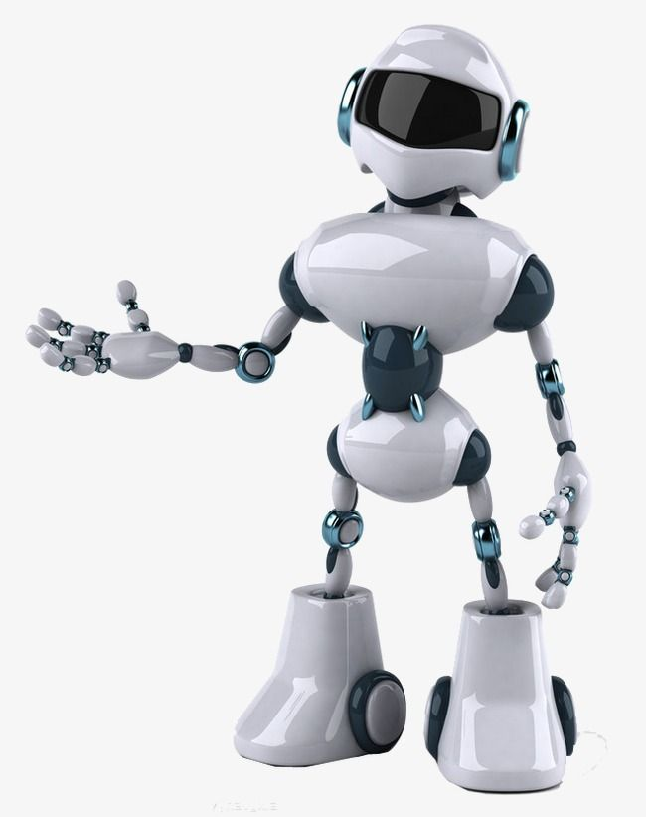
Specification
1. When the user says ”Cook” the robot must first open the window and then make a meal.
2. When the user asks the robot to sit, the robot must be in a ‘no tasks’ state.
3. When the user says ”Playlist” the robot plays music.
4. When the user says ”Silent” the robot silences the music.
5. When the user says ”Do laundry” the robot does your laundry.
6. The robot cannot play or silent the music while it is in a ‘sit’ state.
7. When the user says ”Clean” the robot must first close the window and then start to clean.
8. When the robot is in a ‘sit’ state and half an hour has passed, it will transit into ‘asleep’ state.
9. When the user says ”Asleep” the robot will enter ‘asleep’ state only if it’s current state is ‘sit’.

Slide 8
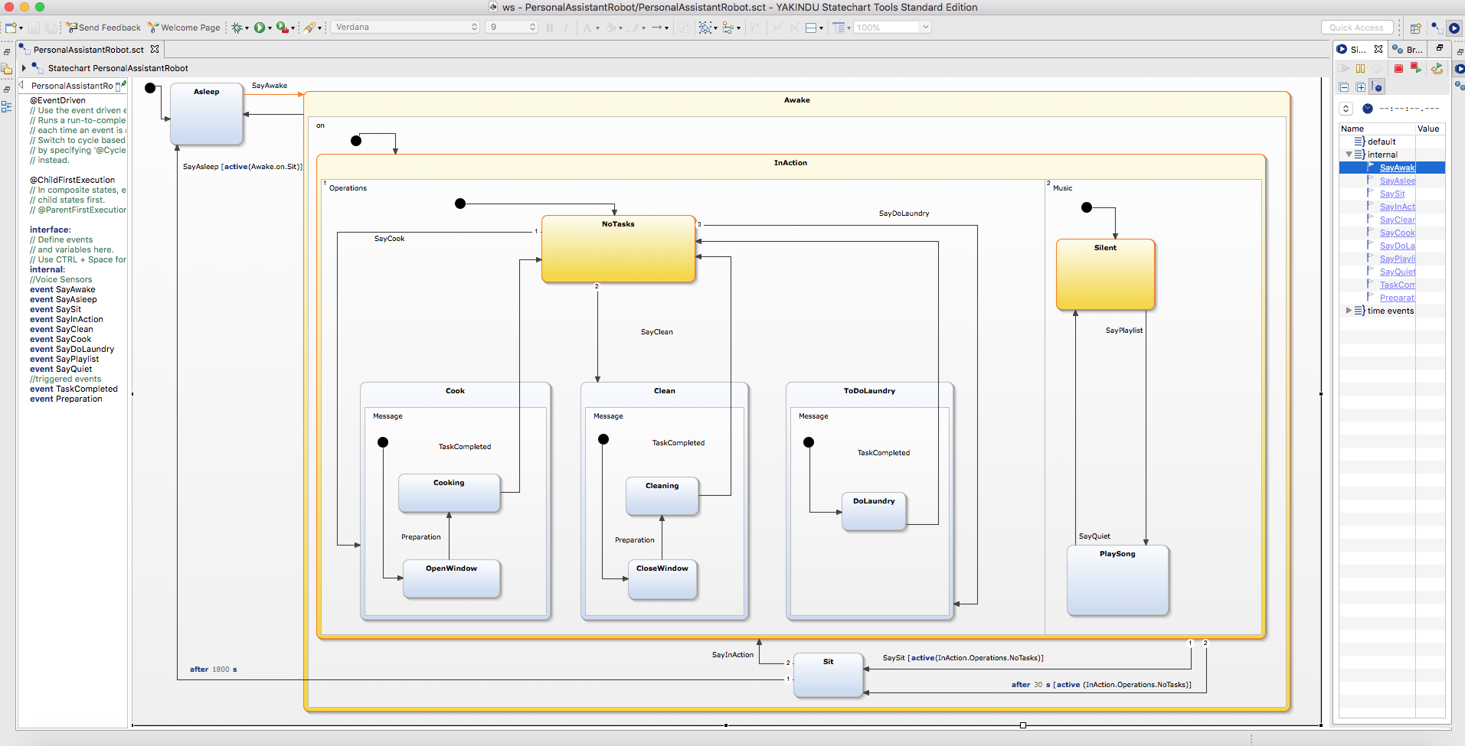
The Statecharts
It can be seen that the personal assistant Robot has two main states: ‘Awake’ or ‘Asleep’.
Within the state of awake, there are two states:
‘in action’ and ‘sit’.

Slide 9
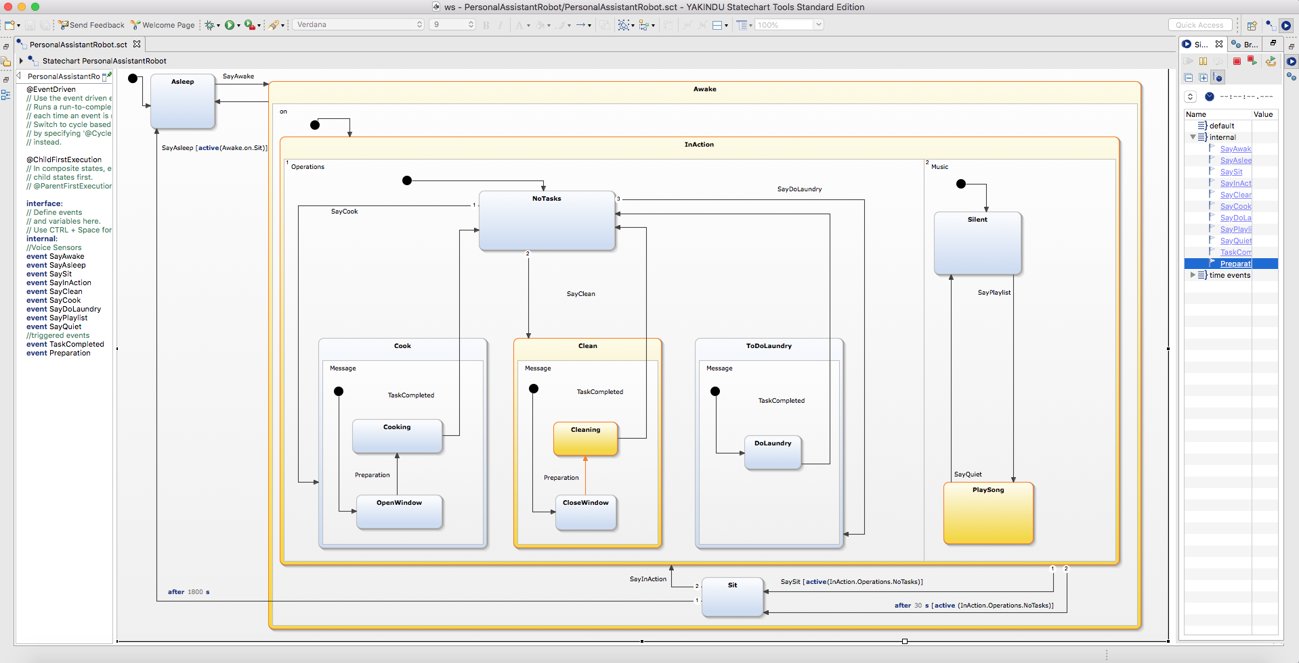
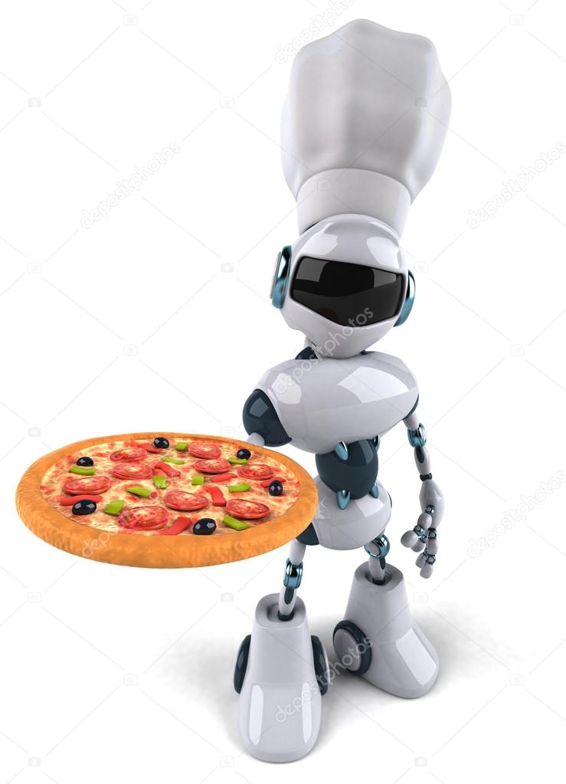

Slide 10
live sequence charts

Slide 11
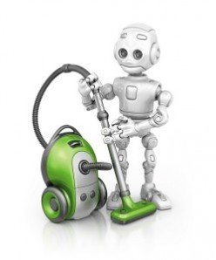
Behavioral requirements
When the user says ”Cook” the robot must first open the window and then make a meal.
When the user says ”Do laundry” the robot does your laundry.
When the user says ”Clean” the robot must first close the window and then start to clean.
When the user says ”Playlist” the robot plays music.
When the user says ”Silent” the robot silences the music.

Slide 12
Controlled language
1. When the user says_cook to the robot and the robot open the window, the robot make a meal.
2. When the robot make a meal and the user says_playlist to the robot, the robot play music.
Forbidden lsc:
3. When the user says_cook to the robot and the robot open the window and the robot make a meal, the robot must never clean.

Slide 13
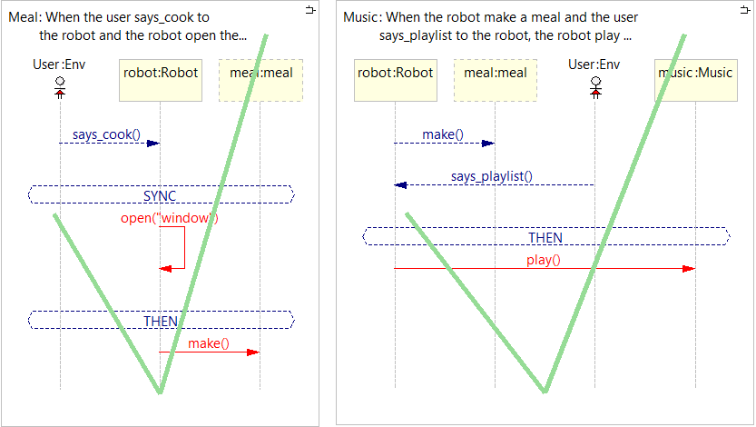
Lsc diagrams

Slide 14
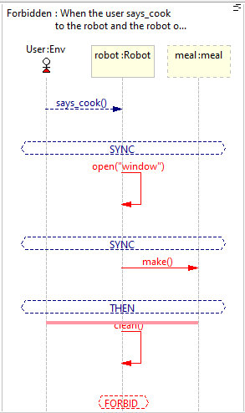

Forbidden lsc
When the user says_cook to the robot and the robot open the window and the robot make a meal, the robot must never clean.

Slide 15
How implemented
Which sentences in Q2 did you create, which couldn’t you? What was the reason?
I created the following sentences: The user tells the robot to make him a meal, the robot first opens the window
(so that the smell comes out of the house) and then cooks for him.
In the next sentence, the robot cooks and at any given time the user can say to the robot "playlist”.
The robot's sensors receive the user's voice and as a result, it plays music while he cooks (or execute any other home task).
”When the robot is in a ‘sit’ state and half an hour has passed, it will transit into ‘asleep’ state”
This sentence was more difficult to program in LSC’s, since this is a situation which depends on time and not based on user’s commands.
I didn’t try the others sentences, because I wanted to use unification in the LSC’s diagrams.

Slide 16

reflection
Since I did the whole project on my own, I learned both the theoretical and the technical parts by myself.
The online learning has it’s downsides, but generally I liked the fact we can pause and rewind the lectures.
I feel that learning the new languages taught me how to characterize a technological product and the thinking process behind it.

